Slide 1
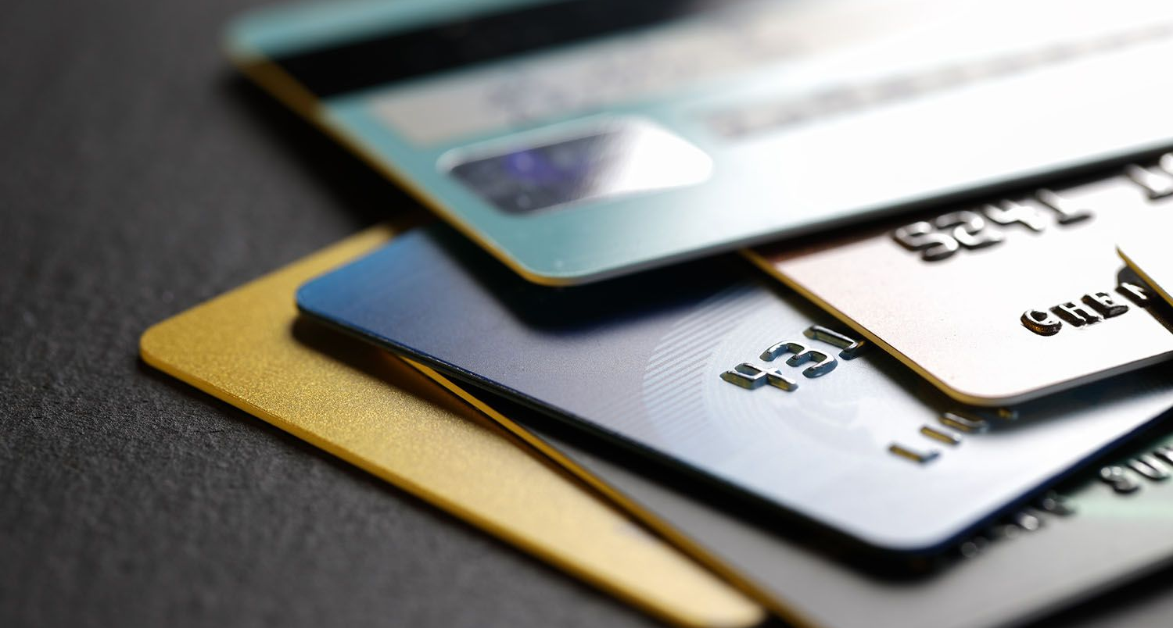
Credit card fraud detection using supervised machine learning
Presented By:
Piyush Kumar (20BCS9107)
Shashank Singh (20BCS9109)
Muskan Kumari (20BCS8285)
Rithik Sharma (20BCS9135)
Akash Kumar (20BCS9110)

Slide 2
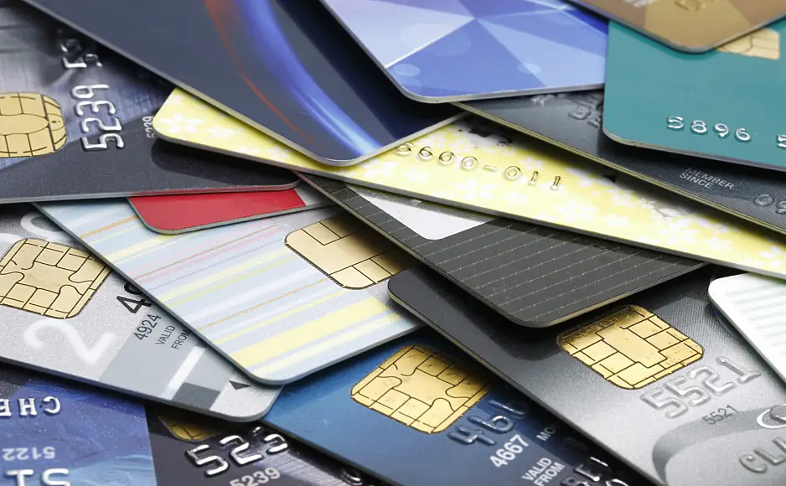

CONTENTS
Introduction
Objectives
Technology Used
Designs
Screenshots
Outcomes

Slide 3

INTRODUCTION
A credit card is a card which is work as an instrument through which users can do online transactions. It is provided by a financial institution or by an organization, it allows users to borrow funds. The limit of the credit card is determined by the credit score, income, and credit history of the user. It can be used for shopping, electricity bills, restaurants, electronic devices, etc.

Slide 4

OBJECTIVES
Our project's main purpose is to make people aware of the ongoing online credit card fraud. To find the machine learning model which gives the best accuracy in detecting online credit card frauds.
Credit card fraud detection using supervised machine learning
4

Slide 5
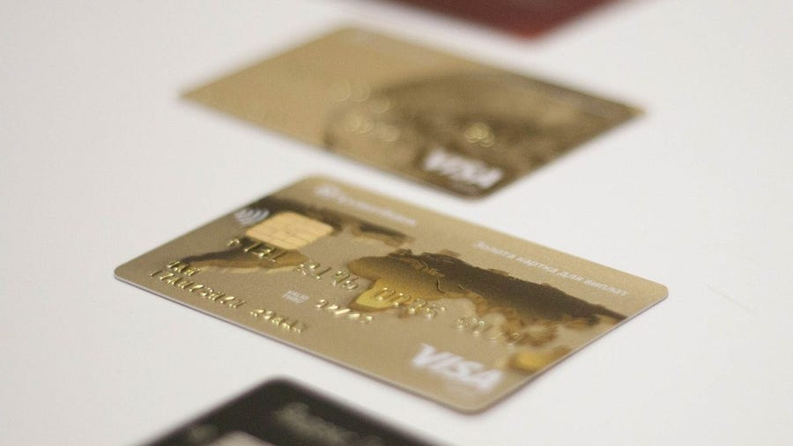



TECHNOLOGY USED
The proposed techniques are used in this paper, for detecting the frauds in credit card system. The comparison are made for different machine learning algorithms such as Logistic Regression, Decision Trees, Random Forest, Naive Bayes to determine which algorithm gives suits best and can be adapted by credit card merchants for identifying fraud transactions. The Figure1 shows the architectural diagram for representing the overall system framework.

Slide 6
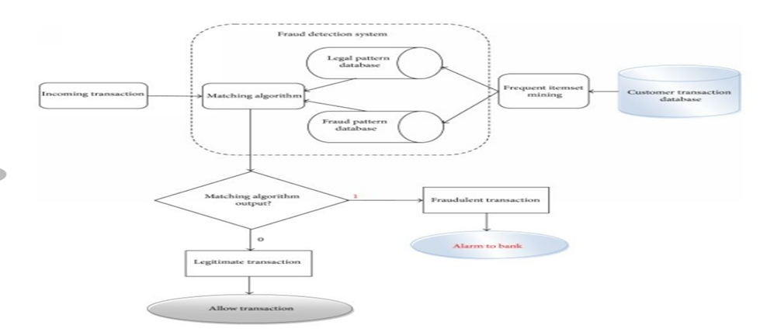
DESIGNS
flow chart

Slide 7
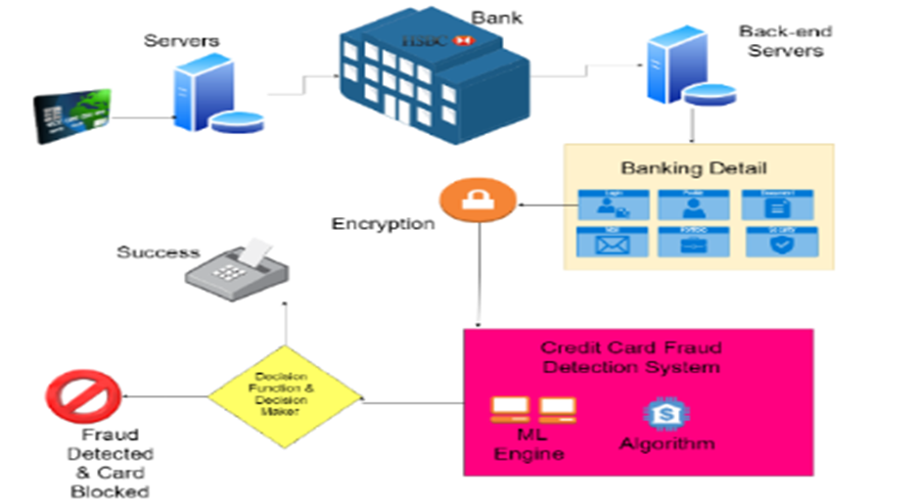
Architecture diagram

Slide 8
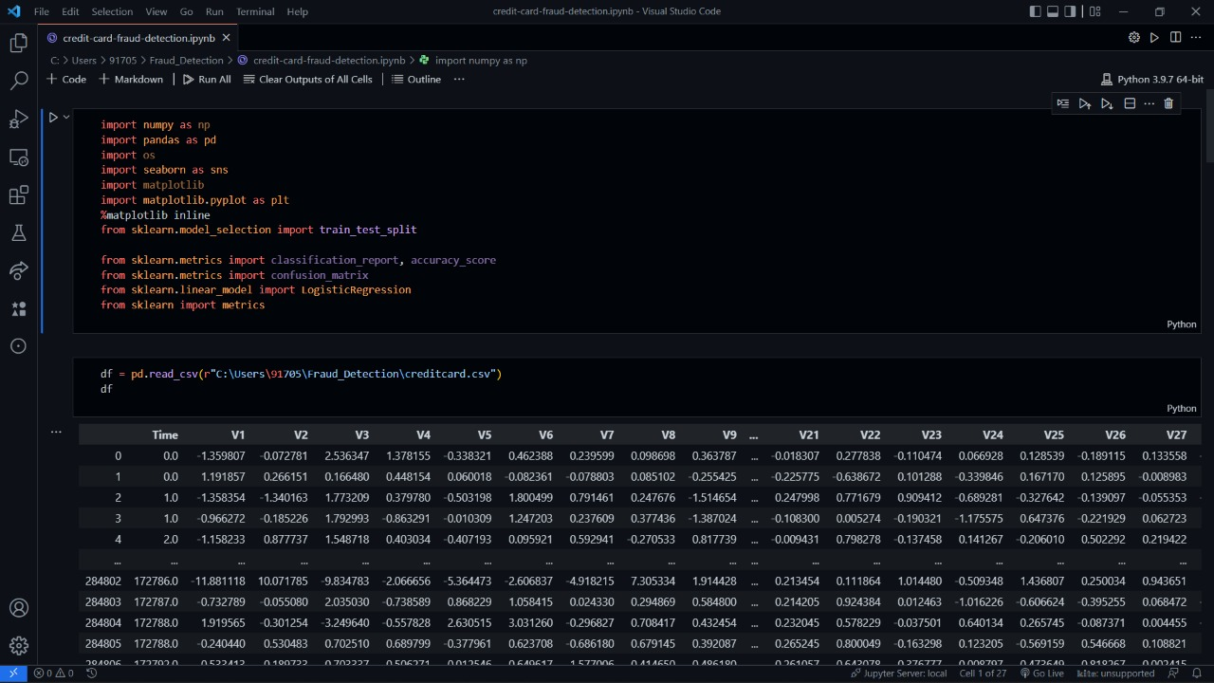
SCREENSHORTS

Slide 9
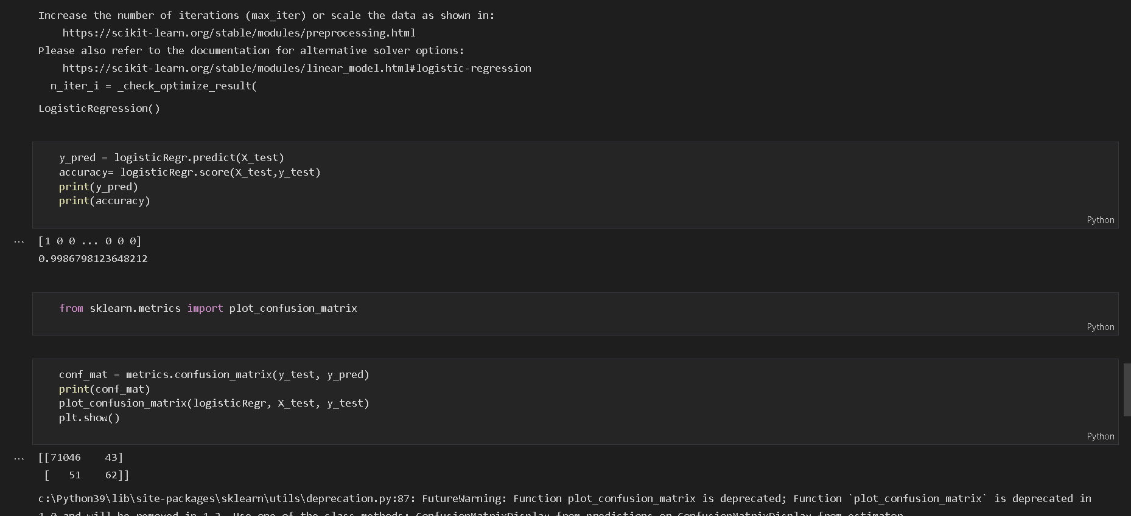

Slide 10
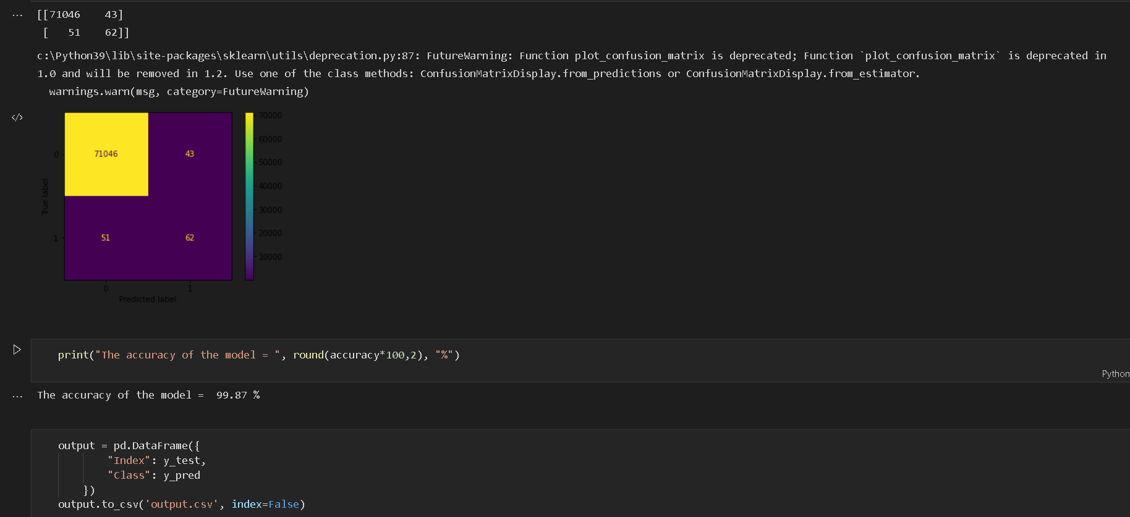

Slide 11
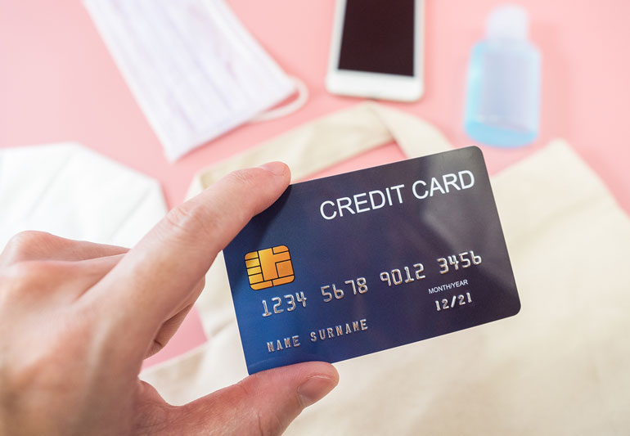

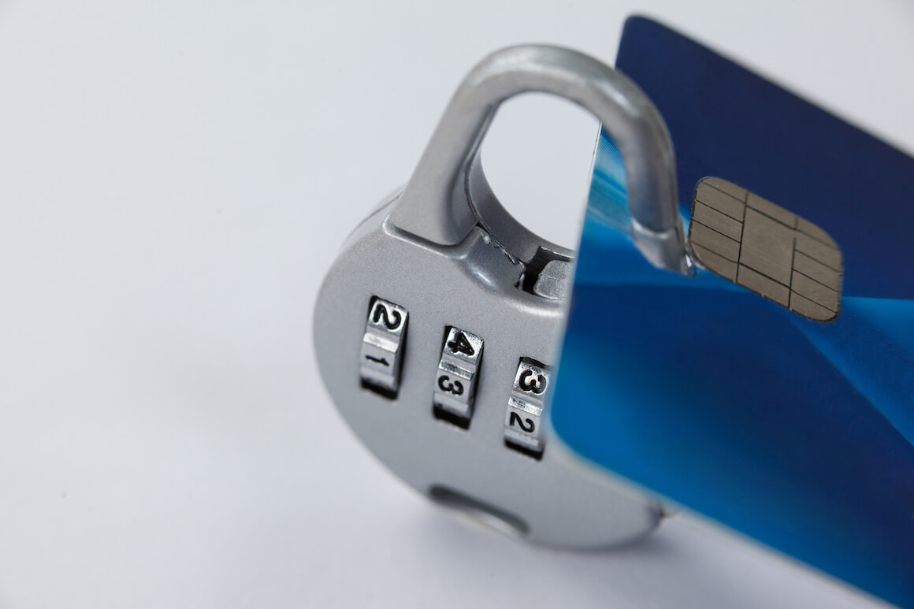

OUTCOMES
In this paper we developed a novel method for fraud detection, where customers are grouped based on their transactions and extract behavioral patterns to develop a profile for every cardholder. Then different classifiers are applied on three different groups later rating scores are generated for every type of classifier. This dynamic changes in parameters lead the system to adapt to new cardholder's transaction behavior timely.

Slide 12
